Slide 1
Introduction of “KVPY” (Kishore Vaigyanik Protsahan Yojana)

Slide 2
ABOUT KVPY
The "Kishore Vaigyanik Protsahan Yojana" (KVPY) is a program started in 1999 by the Department of Science and Technology (DST), Government of India to encourage students who are studying Basic Sciences to take up research career in Science. The aim of the program is to identify and encourage talented and motivated students to pursue career in research.
This program aims to assist the students to realize their potential and to ensure that the best scientific talent is groomed for research and development in the country. Generous fellowship and contingency grant are provided to the selected KVPY Fellows up to the pre Ph.D. level or 5 years whichever is earlier. In addition, summer camps for the KVPY Fellows are organized in prestigious research and educational institutions in the country.
The Department of Science and Technology, the nodal agency of the Government has entrusted the overall responsibility for organizing and running the KVPY Program to the Indian Institute of Science, Bangalore and set up a Management Committee and a National Advisory Committee (NAC) for overseeing its implementation. A core committee looks after both the day-to-day and academic aspects of the KVPY Program.

Slide 3
FELLOWSHIPS
BASIC SCIENCES | Monthly Fellowship | Annual Contingency Grant
SA/SX/SB - during 1st to 3rd years of - B.Sc./B.S./B.Stat./B.Math. / Integrated M.Sc. /M.S. | Rs. 5000 | Rs. 20000
SA/SX/SB - during M. Sc. / 4th to 5th years of Integrated M.Sc. /M.S./M.Math./M.Stat. | Rs. 7000 | Rs. 28000

Slide 4
ELIGIBILITY - 2021
The KVPY Fellowships are given to Indian Nationals to Study in India (Students intending to pursue/pursing under graduate program under Distance Education scheme/correspondence course of any university are not eligible to apply).
Stream SA: Due to prevailing COVID-19 situation, as one-time measure, students who have passed X Standard Board Examination and eligible to enroll in XI standard (Science subjects) during the academic year 2021-22, are eligible to appear for Aptitude test. The student should produce a study certificate of class XI class once they are selected as a provisional KVPY fellow. Moreover, the fellowship of the students selected under this stream will be activated only if they join for an undergraduate course in Basic Sciences (B.Sc./B.S./B.Stat./B.Math./Int. M.Sc./Int. M.S.) in the academic year 2023-24 after having secured a minimum of 60% (50% for SC/ST/PWD) marks in aggregate in MATHEMATICS and SCIENCE subjects in the XII standard Board Examination. During the interim period of one year they will be invited for the National Science (Vijyoshi) Camp and their travel expenses and local hospitality will be met by KVPY.
Stream SX: Students enrolled in XII Standard (Science subjects) during the academic year 2021–22 and aspiring to join undergraduate program in Basic Sciences (B.Sc./B.S./B.Stat./B.Math./Int. M.Sc./Int. M.S) during the academic year 2022-23. The fellowship of the students selected under this stream will be activated only if they join for an undergraduate course in Basic sciences (B.Sc./B.S./B.Stat./B.Math./Int. M.Sc./Int. M.S.) in the academic year 2022-23 after having secured a minimum of 60% (50% for SC/ST/PWD) marks in aggregate in MATHEMATICS and SCIENCE subjects (Physics/Chemistry/Biology) in the XII standard Board Examination.
Stream SB: Due to prevailing COVID-19 situation, as one-time measure, students who have passed XII Standard Board Examination and eligible to enroll in the 1st year B.Sc./B.S./B.Stat./B.Math./Int. M.Sc./Int. M.S. during the academic year 2021–22 are eligible to appear for the aptitude test. The student should produce a study certificate of 1st year B.Sc./B.S./B.Stat./B.Math./Int. M.Sc./Int. M.S once they are selected as a provisional KVPY fellow. Moreover, the fellowship of the students selected under this stream will be activated only if they join an undergraduate program in Basic sciences (B.Sc./B.S./B.Stat./B.Math./Int. M.Sc./Int. M.S) in the academic year 2021-22 and secured a minimum of 60% (50% for SC/ST/PWD) marks in aggregate in 1st year of B.Sc./B.S./B.Math./B.Stat./Int. M.Sc./Int. M.S.

Slide 5
APPLICATIONS-2021
Application for KVPY-2021 must be done online only
There are three steps to complete your application successfully.
Step 1. Registration (http://kvpy.iisc.ac.in/main/KVPY-Instruction-21.html)
Step 2. Filling personal and academic details, choosing test centres and uploading photo, signature and other certificates, as applicable.
Step 3. Payment of application fees. Please note that you must pay the application fee only at the KVPY application portal. This can be done by using a Credit Card, ATM-Debit Card, UPI or Net Banking. No other means of payment will be accepted. Once the payment is successful and application is submitted, no refund of application fee will be done
The application fees for KVPY-2021 are as follows: For General/OBC Category: Rs. 1250, For SC/ST/PWD: Rs. 625 (Bank Charges extra)
Important Dates
Opening of online application portal | : 12th July 2021 at 5 PM
Date for closing of online application | : 25th August 2021
Exam Date | : 7th November 2021

Slide 6
SELECTION PROCEDURE
Aptitude Test:
Candidates meeting the eligibility criteria for various streams, will be called for aptitude test conducted both in Hindi and English at different centers across the country on Sunday, the 7th November 2021.
Admit Card:
Students may download the admit card for the aptitude test from the website from the second week of October 2021
Other Privileges
Each KVPY Fellow will be issued an Identity Card so as to have access to National Laboratories/ Universities who have agreed to extend special privileges like library, laboratory facilities, etc. to KVPY Fellows on production of the ID card. Our Goal
We hope that the award of the Fellowship to a student acts as an encouragement and motivation to take up research in a subject in B.S. (Basic Sciences) of their liking that induces the student to choose a research career.

Slide 7
What is the Syllabus for the aptitude Test ?
There is no prescribed syllabus for the aptitude test. The aptitude test aims to test the understanding and analytical ability of the student than his/her factual knowledge. However, students are tested for the syllabus up to class X/XII/1st year of B.Sc./B.S./B.Stat./B.Math./Int. M.Sc./M.S. as applicable.
Syllabus Pattern KVPY Class XI
Syllabus Pattern KVPY Class XII
Part-A (1 Marks) | No of Questions | Part-B (2 Marks) | No of Questions
Mathematics: | 15 | Mathematics: | 5
Physics: | 15 | Physics: | 5
Chemistry: | 15 | Chemistry: | 5
Biology: | 15 | Biology: | 5
Total: 60 Marks |  | Total: 40 Marks
Part-A (1 Marks) | No of Questions | Part-B (2 Marks) | No of Questions
Mathematics: | 20 | Mathematics: | 10
Physics: | 20 | Physics: | 10
Chemistry: | 20 | Chemistry: | 10
Biology: | 20 | Biology: | 10
Total: 80 Marks |  | Total: 80 Marks

Slide 8
KVPY Syllabus for Stream SA

Slide 9
KVPY Syllabus for Stream SX

Slide 10
KVPY Syllabus for Stream SB

Slide 11
RESULTS
KVPY Fellowship Award - 2019
Following is the provisional list of candidates in the order of merit, recommended for the Award of KVPY Fellowship-2019. The merit list is based on the marks obtained by a Candidate: 75 % of the marks in the Aptitude Test + 25 % of the marks in the Interview.
All India Rank List – General Merit and cut off marks:
Stream – SA (53.00 % and above)
Stream – SX (55.00 % and above)
Stream – SB (50.00 % and above)
All India Rank List under Empowerment Initiative for SC/ST students in the KVPY Fellowship Program and cut off marks:
Stream – SA (42.00 % and above)
Stream – SX (45.00 % and above)
Stream – SB (40.00 % and above)
All India Rank List under Empowerment Initiative for PWD students in the KVPY Fellowship Program and cut off marks:
Stream – SA (42.00 % and above)
Stream – SX (45.00 % and above)
Stream – SB (40.00 % and above)

Slide 12
Colleges which accept KVPY score are as follows:
CV Raman Global University, [CGU] Bhubaneswar
International Institute of Information Technology, [IIIT] Hyderabad
Indian Institute of Science Education and Research, [IISER] Pune
Indian Institute of Science, [IIS] BangaloreIndian
Institute of Science Education and Research, [IISER] Bhopal
Indian Institute of Science Education and Research, Mohali
Indian Institute of Science Education and Research, Trivandrum

Slide 13
KVPY Previous Year Result:
Result 2019

Slide 14
KVPY Result 2017:

Slide 15
KVPY Result 2016:
Category | Shortlisted for Interview (Gen, OBC) | Final Selection (Gen. OBC) | Shortlisted for Interview (SC/ST) | Final Selection (SC/ST) | Shortlisted for Interview (PWDT) | Final Selection (PWD
SA | 1323 | 877 | 102 | 74 | 4 | 4
SX | 1782 | 1523 | 261 | 169 | 10 | 6
SB | 183 | 116 | 32 | 18 | 2 | 1
Total | 3288 | 2516 | 395 | 261 | 16 | 11

Slide 16
KVPY Result 2015:

Slide 17
KVPY Result 2014:

Slide 18
Practice Questions :
Q.1. Depict the shown v – x graph in a – x graph:

Slide 19
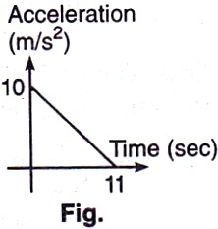
Practice Questions :
Q. 2.- A particle starts from rest. Its acceleration (a) versus time (t) is as shown in Fig. The maximum speed of the particle will be :
110 ms^{–1} (b) 55 ms^{–1}
(c) 550 ms^{–1} (d) 660 ms^{–1}

Slide 20
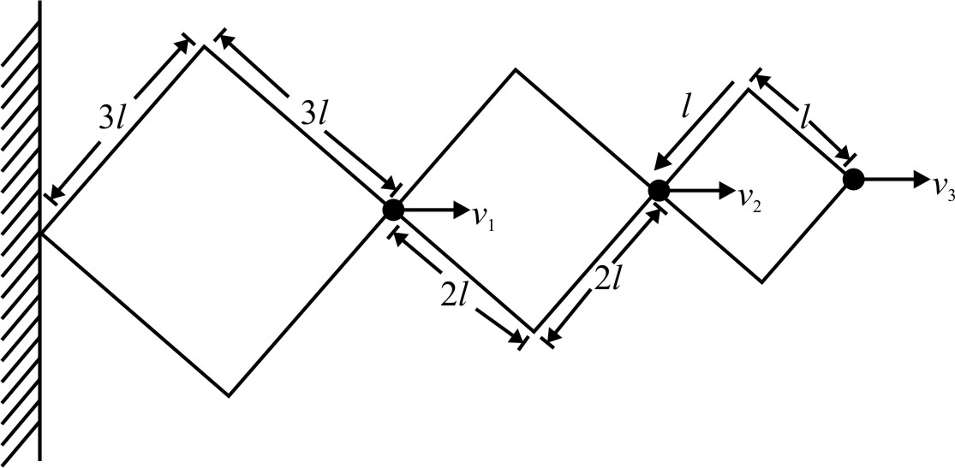
Practice Questions :
Q.3.- In the given figure find out v₁ : v₂ : v₃ = ?

Slide 21
Thank You! Any Question?

